Slide 1
Managing the COVID – 19 pandemic in care homes
Martlets Hospice

Slide 2
Objectives of the session
Understand Key recommendations for managing COVID – 19 in care homes, including:
Infection control precautions
Staff training as needed – vital signs
Level of frailty measure
Recognising deterioration (RESTORE2 tool)
Residents who ‘walk with purpose’
Advance care planning review – COVID-19 – escalation decision
New admissions – receiving back residents for hospital

Slide 3
Introduction to why COVID-19 management is needed in care homes
Care home residents outnumber acute beds in England by 3 times
Most have multiple health conditions and physical dependency
Care home residents are vulnerable due to health conditions and advanced frailty
If become hypoxic, the prognosis is very poor
As hospitals become overwhelmed by COVID-19, ability to deliver care will be difficult
Care home staff may need extra training and support to recognise and manage acutely unwell residents or for infectious disease management

Slide 4
Identifying resident with suspected COVID - 19
Public Health England suggest COVID-19 should be suspected if:
Fever of at least 37.8 and at least one other of:
New persistent cough
Hoarseness
Nasal discharge/congestion
Shortness of breath
Sore throat
Wheezing
Sneezing
However COVID-19 care home residents may also present with non-respiratory tract symptoms such as:
New or worsening confusion or diarrhoea
Care home staff are the best at spotting the ‘soft signs’ of deterioration

Slide 5
Infection control precautions
Any resident suspected needs to be isolated in their room (GP to be notified)
Commence use of PPE (gloves, aprons and facemasks)
Care home not to allow visiting for any residents (this will be difficult in End of Life Care)
If large numbers are suspected of having COVID-19 then care home needs to look at separating those residents suspected and those not

Slide 6
Staff training needs
All staff need to be able to take observations (which isn’t the norm for care home without nursing – but health care workers in care homes with nursing may also need training)
Vital observation equipment needs to be available in every home - if this is not, then it needs to be provided or purchased
(pulse oximetry, heart rate, blood pressure, respiratory rate)
https://westhampshireccg.nhs.uk/restore2/restore2-training-and-resources/ this has a wealth for training videos available.
(Rockwood) Clinical Frailty Scale likely to be used when triaging patient to be admitted to hospital https://em3.org.uk/foamed/24/4/2017/lightning-learning-clinical-frailty-scale

Slide 7
RESTORE2 – a detection and escalation tool for care homes
Recognise Early soft Signs
Take Observations
Respond
Escalate
4 key components:
soft signs
physical observations
escalation pathway (NEWS – National Early Warning Score)
SBARD – Situation, Background, Assessment, Recommendations, Decision

Slide 8
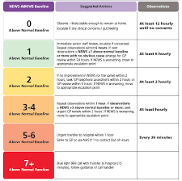

Slide 9
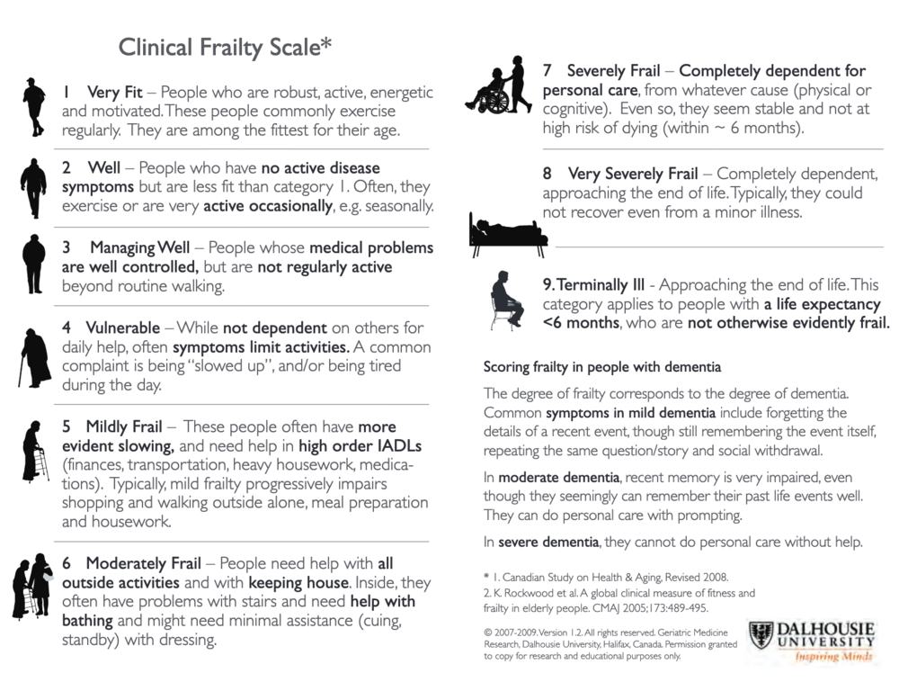
Recognising deterioration and frailty levels
RESTORE2/RESTORE mini
Recognise Early Soft Signs, Take Observations, Respond, Escalate

Slide 10
Advance care plan review and escalation decision
Care home staff to start or revisit the advance and emergency care planning with all residents and or family
https://www.rcgp.org.uk/clinical-and-research/resources/toolkits/palliative-and-end-of-life-care-toolkit.aspx
GP/primary care teams will aim to triage residents remotely basing decision on carer concern and vital signs.
Discussion must include hospital admission, goals of care and ceilings of treatment
All decision need to be shared with primary care and out of hours services
The decision will be made at the time of need with COVID-19
Residents and families should be made aware that if they wish for hospitalisation and intensive care in the case of COVID-19, this wish may not ultimately be put into practice if there is a lack of medical grounds for this

Slide 11
Residents that ‘walk with purpose’
These patients pose a very difficult challenge and need to take time to understand the person’s individual behaviour and try to modify if possible
Physical restraint isn’t acceptable
At present there isn’t any relaxation on DoLS so normal guidelines should be adhered to

Slide 12
What else to consider
Using teleconferencing/video calling to communicate with residents and their loved ones
Social isolation for these residents are highly likely during this period
That hospitals will expect care home to take residents back in to their care homes and manage them in their home environment
Difficult conversation document – please refer to guidance on using video/teleconferencing and being prepared

